Slide 1


Santosh Kumar Kar,
skkar.2k2@gmail.com

Slide 2
CHAPTER – 1
Spring Micro Services
Santosh Kumar Kar,
skkar.2k2@gmail.com

Slide 3
What is Web Service
It is a client-server application or application component for communication.
The method of communication between two devices over the network.
It is a software system for the interoperable machine to machine communication.
It is a collection of standards or protocols for exchanging information between two devices or application.

Slide 4
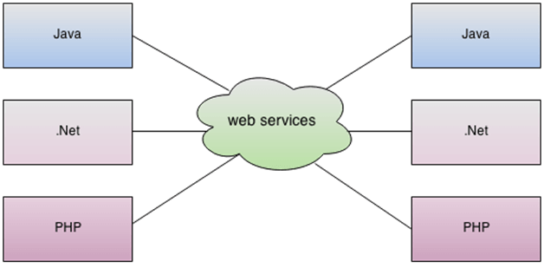
What is Web Service

Slide 5
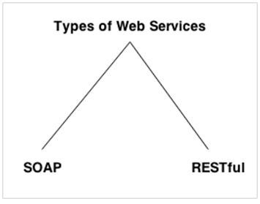
Types of Web Services

Slide 6
SOAP Services
Advantages
WS Security: SOAP defines its own security known as WS Security.
Language and Platform independent: SOAP web services can be written in any programming language and executed in any platform.
Disadvantages
Slow: SOAP uses XML format that must be parsed to be read. It defines many standards that must be followed while developing the SOAP applications. So it is slow and consumes more bandwidth and resource.
WSDL dependent: SOAP uses WSDL and doesn't have any other mechanism to discover the service.

Slide 7
Rest Services
Fast: RESTful Web Services are fast because there is no strict specification like SOAP. It consumes less bandwidth and resource.
Language and Platform independent: RESTful web services can be written in any programming language and executed in any platform.
Can use SOAP: RESTful web services can use SOAP web services as the implementation.
Permits different data format: RESTful web service permits different data format such as Plain Text, HTML, XML and JSON.

Slide 8
SOAP vs REST
No. | SOAP | REST
1) | SOAP is a protocol. | REST is an architectural style.
2) | SOAP stands for Simple Object Access Protocol. | REST stands for REpresentational State Transfer.
3) | SOAP can't use REST because it is a protocol. | REST can use SOAP web services because it is a concept and can use any protocol like HTTP, SOAP.
4) | SOAP uses services interfaces to expose the business logic. | REST uses URI to expose business logic.
5) | JAX-WS is the java API for SOAP web services. | JAX-RS is the java API for RESTful web services.
6) | SOAP defines standards to be strictly followed. | REST does not define too much standards like SOAP.
7) | SOAP requires more bandwidth and resource than REST. | REST requires less bandwidth and resource than SOAP.
8) | SOAP defines its own security. | RESTful web services inherits security measures from the underlying transport.
9) | SOAP permits XML data format only. | REST permits different data format such as Plain text, HTML, XML, JSON etc.
10) | SOAP is less preferred than REST. | REST more preferred than SOAP.

Slide 9
Software Architecture Patterns
Layered Architecture (aka n-tier architecture pattern)
Event-Driven Architecture.
Microkernel Architecture.
Microservices Architecture Pattern.
Space-Based Architecture.

Slide 10


Micro Service

Slide 11
What is Microservice
Highly maintainable and testable
Loosely coupled
Independently deployable
Organized around business capabilities
Owned by a small team

Slide 12
Key principles
Autonomy-
each service operates and changes independently of others
Resilience
application or infrastructure failure may only affect part of your system
Transparency
Each application generate separate log metrics
Automation
Alignment

Slide 13
The Twelve Factors
https://12factor.net/

Slide 14

Difference between Monolithic Application & Microservice Application

Slide 15
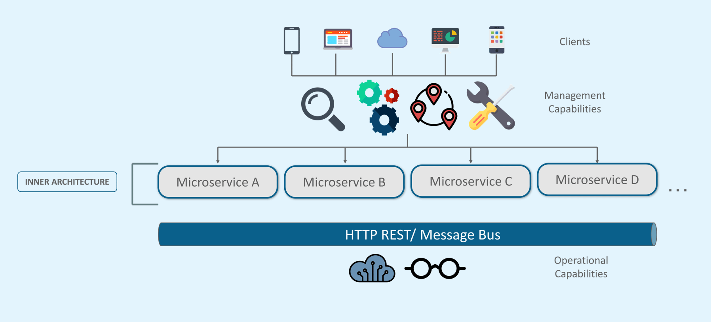
Microservice Architecture

Slide 16
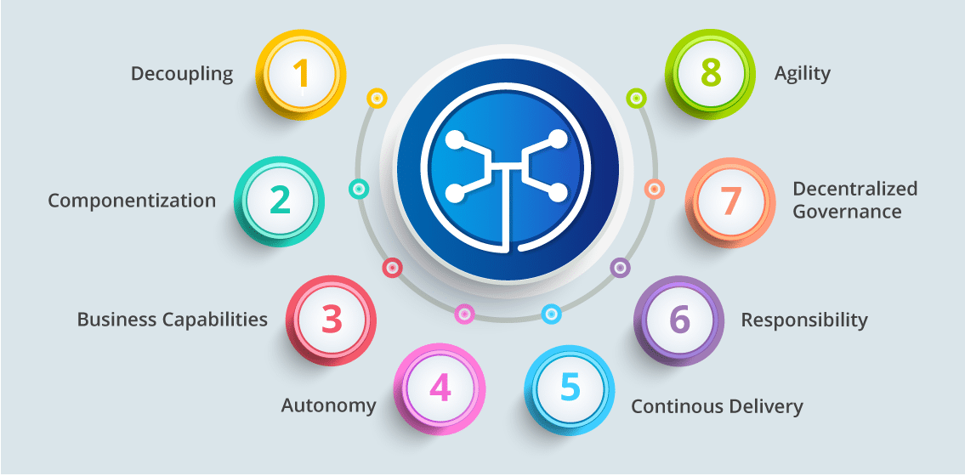
Microservice Features

Slide 17

Companies use Microservice

Slide 18
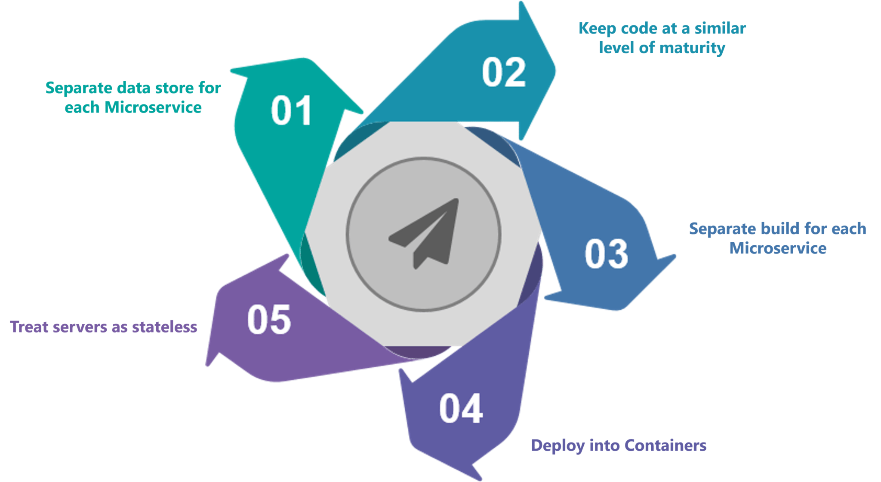
Best Practice to design Microservice

Slide 19
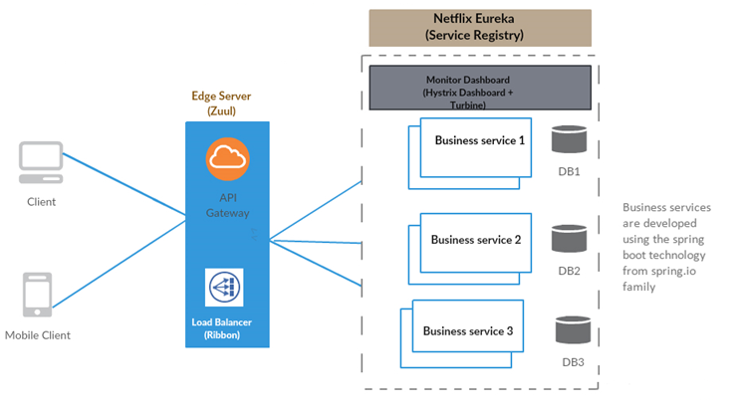

Slide 20
Applying Micro-Service architecture pattern language

Slide 21
Decision #1
Monolithic architecture?
or
Microservice Architecture?

Slide 22
Decision #2: How to decompose an application into services
Decompose by business capability
define services corresponding to business capabilities
Decompose by subdomain
define services corresponding to DDD subdomains

Slide 23
Decision #3: how to maintain data consistency and perform queries
Database per Service pattern
Shared Database pattern
Saga
CQRS (Command Query Responsibility Segregation)

Slide 24
Decision #4 Testing the application
Service Component Test
Integration Test
Consumer-side contract test (Request/Response with Web methods)

Slide 25
Decision #5 Deployment patterns
Multiple service instances per host
Service instance per host
Service instance per VM
Service instance per Container
Serverless deployment
Service deployment platform

Slide 26
Decision #6 Communication styles
Remote Procedure
Invocation Messaging
Domain-specific protocol

Slide 27
Decision #7 External API
API gateway
(Single API gateway for Mobile, Web or any 3rd party client)
Uses common service
Backend for front-end
(Separate API gateways for Mobile, Web or any 3rd party client)
Each API shares common service

Slide 28
Decision #8 Service discovery
Client-side discovery
Server-side discovery
Service registry
Self registration
3rd party registration

Slide 29
Decision #9 Reliability
Circuit Breaker

Slide 30
Decision #10 Security
Access Token

Slide 31
Decision #11 Observability
Log aggregation
Application metrics
Audit logging
Distributed tracing
Exception tracking
Health check API
Log deployments and changes

Slide 32

Microservices
with
Spring

Slide 33
Restful Services through Spring Boot
Spring Rest Controller
Spring Data JPA
Docunentating Restful APIs
Spring Cloud

Slide 34
Rest methods
Get
Post
Delete
Put

Slide 35
Richardson Maturity Model (Martin Fowler)
Level 0
Level 1 - Resources
Level 2 - HTTP Verbs
Level 3 - Hypermedia Controls
The Meaning of the Levels

Slide 36
Level 0
API designed at this level are not at all Rest APIs and This is where SOAP based web services takes place.
No concept of Resource Based URI, Hypermedia, and no proper use of HTTP Protocol (which are key characteristics of a REST API).
These services have a single URI and use a single HTTP method (typically POST)
Does not make use of any of URI, HTTP Methods, and HATEOAS capabilities
Details and Data are sent through the Request Body
Check order status
POST /orderService
Create a new order
Delete an existing order

Slide 37
Level 1 - Resources
REST’s ‘resources’ are the core pieces of data that your application acts on
These will often correspond to the Models in your application(MVC)
API design at Level 1 is all about using different URLs to interact with the different resources in your application (typically POST methods)
POST /orderService/findOrder
Check order status
POST /orderService/findOrder
Create a new order
POST /orderService/deleteOrder
Delete an existing order

Slide 38
Level 2 - Methods
Each URI is associated to a request method
For each operation we find use the appropriate HTTP verbs
GET /orderService/order
Check order status
POST /orderService/order
Create a new order
DELETE /orderService/order
Delete an existing order

Slide 39
Different HTTP Methods
Method | Scope | Semantics
GET | Collection | Retrieve all resources in a collection
GET | Resource | Retrieve a single resource
HEAD | Collection | Retrieve all resources in a collection (header only)
HEAD | Resource | Retrieve a single resource (header only)
POST | Collection | Create a new resource in a collection
PUT | Resource | Update a resource
PATCH | Resource | Update a resource
DELETE | Resource | Delete a resource
OPTIONS | any | Return available HTTP methods and other options

Slide 40
Level 3 - Hypermedia Controls
Your API must implement the concept of HATEOAS
Your response must include a logical link(s) for the resources that your API is having

Slide 41
SWAGGER

Slide 42
Documenting API - Swagger
Swagger™ is a project used to describe and document RESTful APIs.
Most popular than other frameworks such as RAML, Summation etc.
Offers both human readable and machine readable format of documentation
Provides both JSON and UI support.

Slide 43
1. Add Dependency
<dependency>
<groupId>io.springfox</groupId>
<artifactId>springfox-swagger2</artifactId>
<version>2.4.0</version>
</dependency>
<dependency>
<groupId>io.springfox</groupId>
<artifactId>springfox-swagger-ui</artifactId>
<version>2.4.0</version>
</dependency>

Slide 44
2. Swagger Configuration
@Configuration
@EnableSwagger2
public class SwaggerConfig {
@Bean
public Docket api() {
return new Docket(DocumentationType.SWAGGER_2);
}
}

Slide 45
Write required Rest Controllers as per your business
@RestController
public class TestController {
@PostMapping("/employee")
public ResponseEntity<Object> save() {
ResponseEntity<Object> e =
new ResponseEntity<Object>(HttpStatus.ACCEPTED);
return e;
}
@GetMapping("/employee/{eid}")
public ResponseEntity<Object> find(@PathVariable("eid") Long empId) {
ResponseEntity<Object> e =
new ResponseEntity<Object>(HttpStatus.ACCEPTED);
return e;
}
@DeleteMapping("/employee/{eid}")
public ResponseEntity<Object> delete(@PathVariable("eid") Long empId) {
ResponseEntity<Object> e =
new ResponseEntity<Object>(HttpStatus.ACCEPTED);
return e;
}

Slide 46
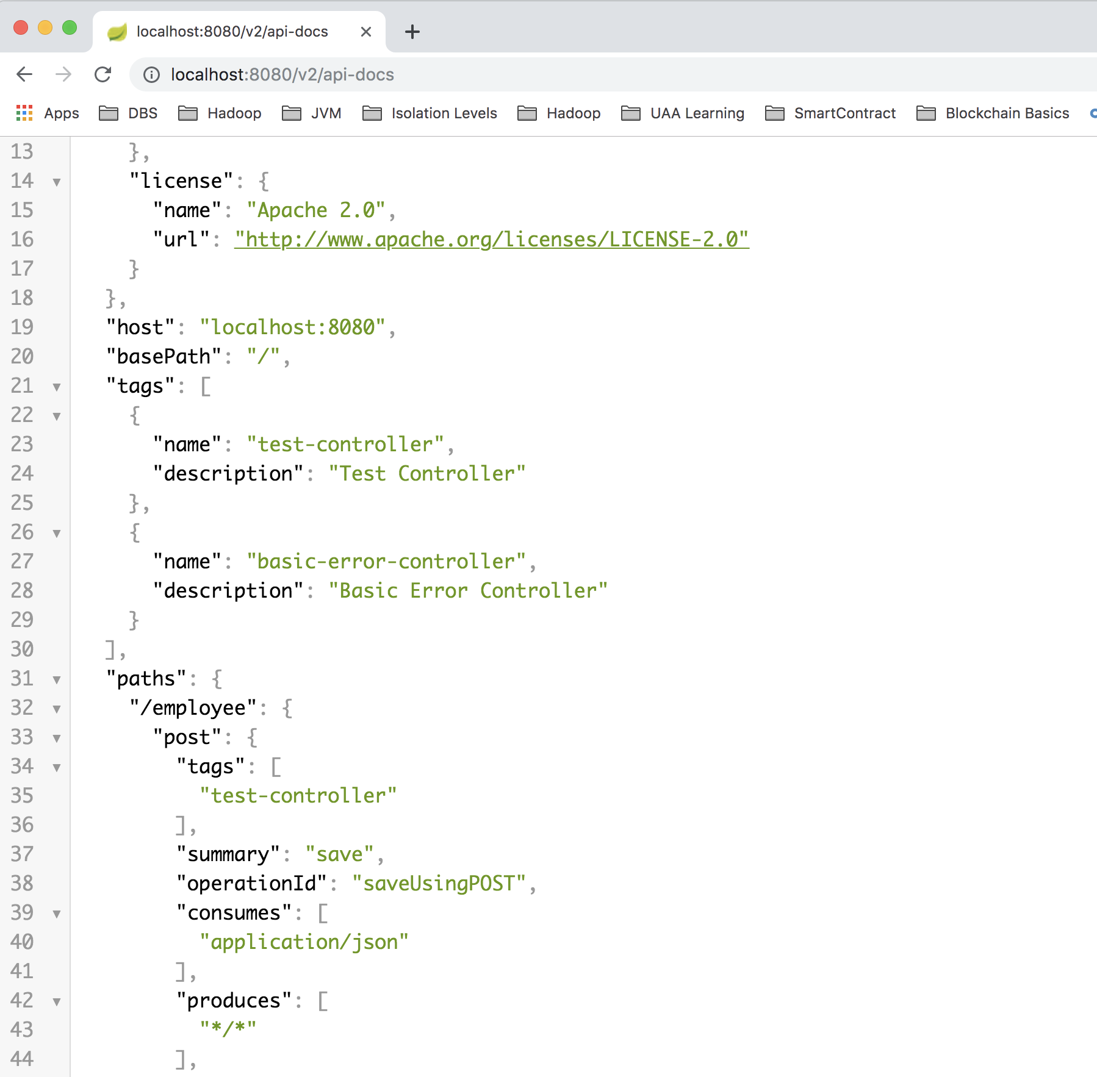
Access the URLs http://localhost:8080/v2/api.docs

Slide 47
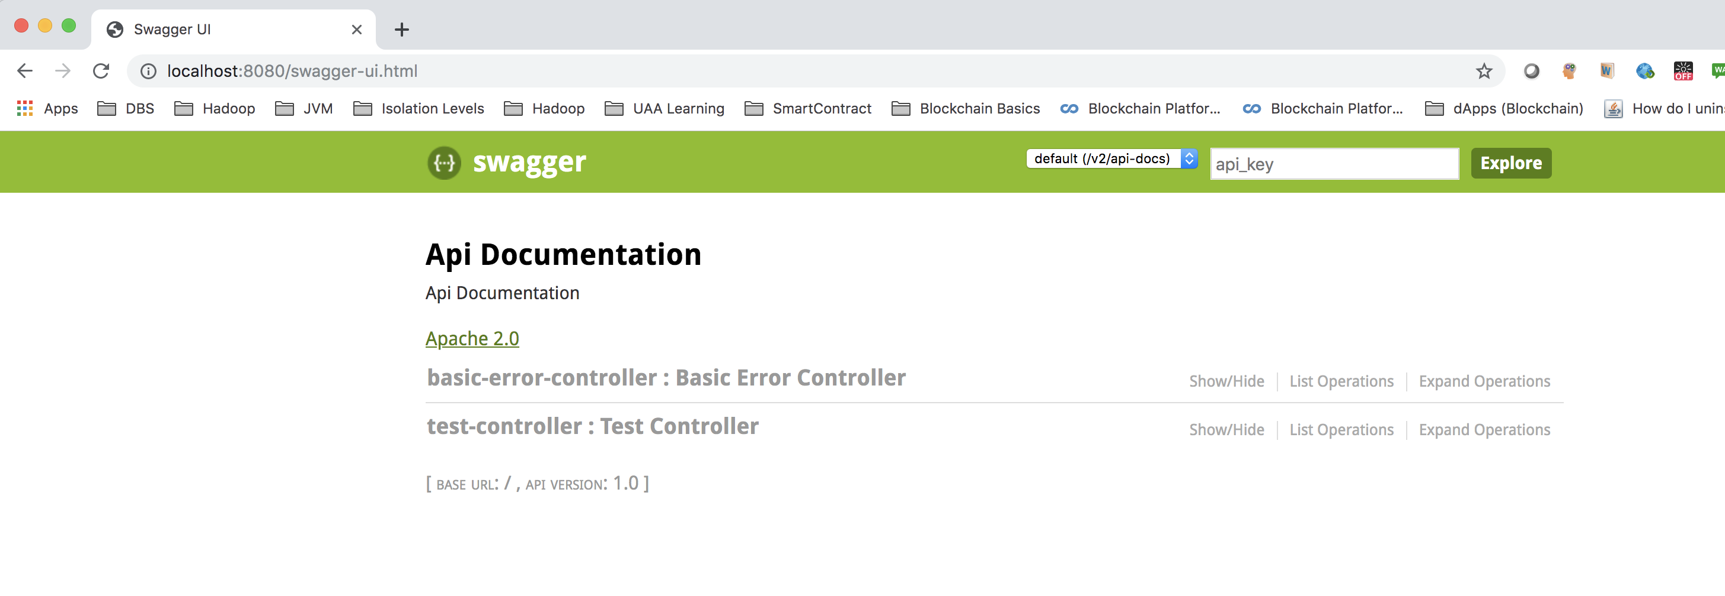
Swagger-ui http://localhost:8080/swagger-ui.html

Slide 48
ACTUATOR

Slide 49
Things to do
1. Add the starter dependency for Actuator
2. access the URL:
https://localhost:8080/actuator

Slide 50
Now in application.properties add:
management.endpoints.web.exposure.include=*
management.endpoints.web.exposure.exclude=loggers
(Don’t use * in prod as it may hit the performance. Use only those beans which you really want)
And access the URL
https://localhost:8080/actuator

Slide 51
Versioning

Slide 52
Why versioning is required?
When your API has reached the point of expanding beyond it’s original intent and capacity, it’s time to consider the next version.

Slide 53
URI Versioning
http://localhost:8080/v1/student
http://localhost:8080/v2/student
@RestController
public class StudentVersioningController {
@GetMapping("v1/student")
public StudentV1 studentV1() {
return new StudentV1("Bob Charlie");
}
@GetMapping("v2/student")
public StudentV2 studentV2() {
return new StudentV2(new Name("Bob", "Charlie"));
}
}

Slide 54
Request Parameter versioning
http://localhost:8080/student/param?version=1
http://localhost:8080/student/param?version=2
@RestController
public class StudentVersioningController {
@GetMapping(value = "/student/param", params = "version=1")
public StudentV1 paramV1() {
return new StudentV1("Bob Charlie");
}
@GetMapping(value = "/student/param", params = "version=2")
public StudentV2 paramV2() {
return new StudentV2(new Name("Bob", "Charlie"));
}
}

Slide 55
(Custom) Headers versioning
http://localhost:8080/student/header
headers=[X-API-VERSION=1]
http://localhost:8080/student/header
headers=[X-API-VERSION=2]
@RestController
public class StudentVersioningController {
@GetMapping(value = "/student/header", headers = "X-API-VERSION=1")
public StudentV1 headerV1() {
return new StudentV1("Bob Charlie");
}
@GetMapping(value = "/student/header", headers = "X-API-VERSION=2")
public StudentV2 headerV2() {
return new StudentV2(new Name("Bob", "Charlie"));
}
}

Slide 56
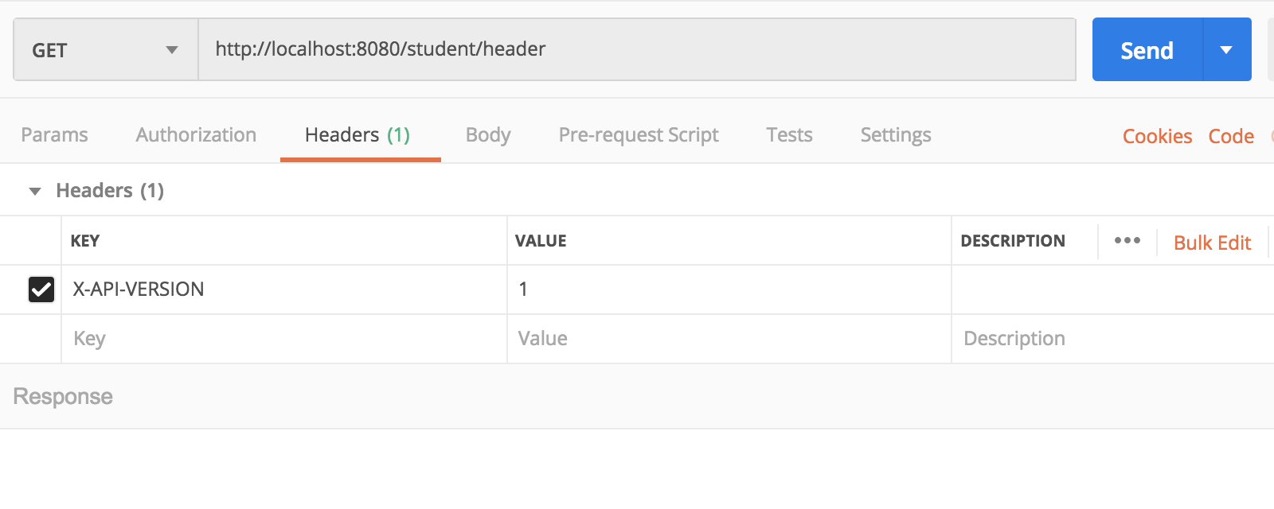
Testing in postman

Slide 57
Media type versioning or (“content negotiation” or “accept header”)
http://localhost:8080/person/produces
headers[Accept=application/vnd.company.app-v1+json]
http://localhost:8080/person/produces
headers[Accept=application/vnd.company.app-v2+json]
@RestController
public class StudentVersioningController {
@GetMapping(value = "/student/produces",
produces = "application/vnd.company.app-v1+json")
public StudentV1 producesV1() {
return new StudentV1("Bob Charlie");
}
@GetMapping(value = "/student/produces",
produces = "application/vnd.company.app-v2+json")
public StudentV2 producesV2() {
return new StudentV2(new Name("Bob", "Charlie"));
}
}

Slide 58
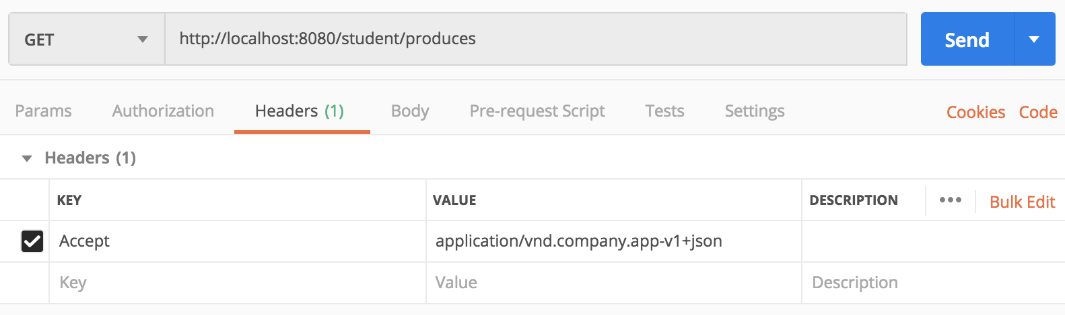
Testing in postman

Slide 59
Basic Authentication

Slide 60
Spring Security
Prevents unauthorized users from viewing the page through the Spring controllers
Adds a barrier that forces the user to sign in before seeing that page

Slide 61

Configuring Spring Security Step-1: Add security-starter dependency for
<dependency>
<groupId>org.springframework.boot</groupId>
<artifactId>spring-boot-starter-security</artifactId>
</dependency>
Try accessing a rest controller after adding the dependency

Slide 62
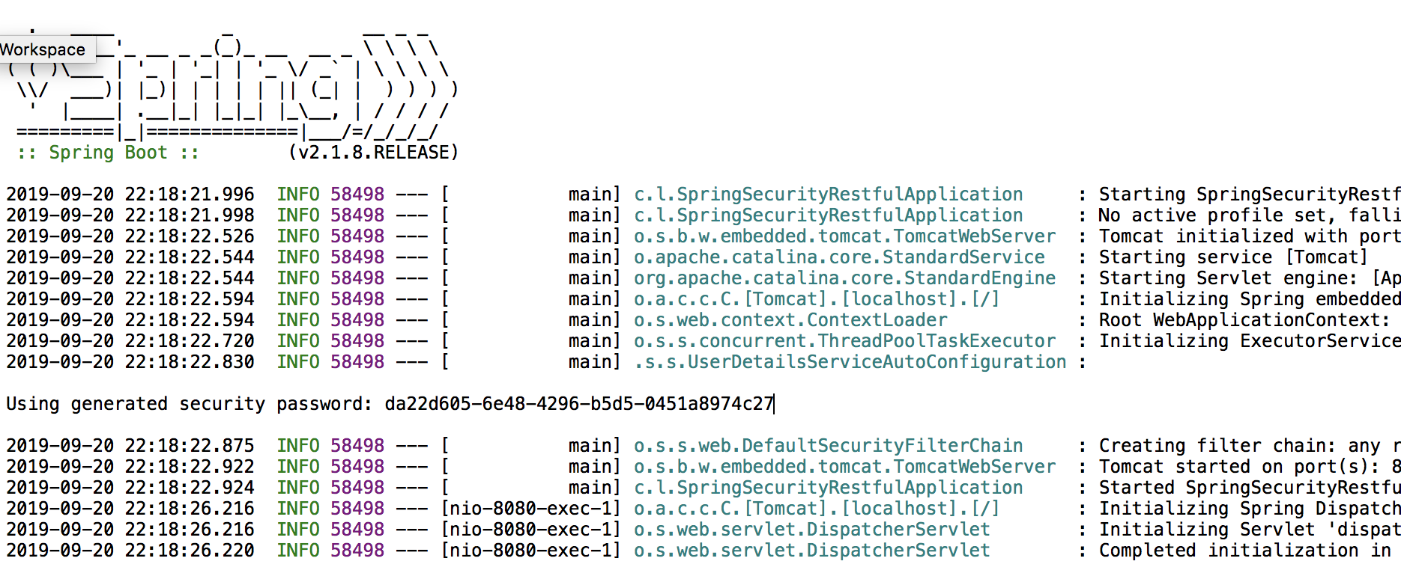
Start the server, observe the password
Default username:
user
Default password:
Auto generated, find from console

Slide 63
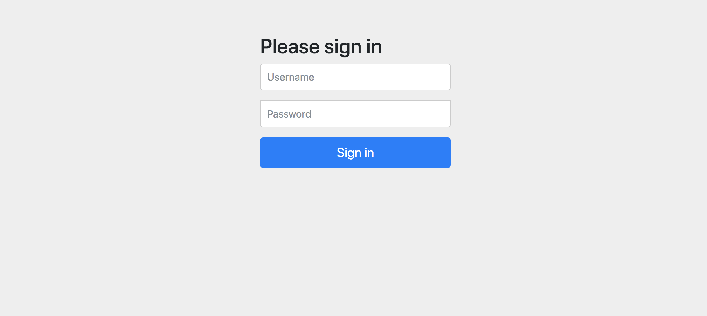
The login page – Auto created
Username: user
Password: as shown in console

Slide 64
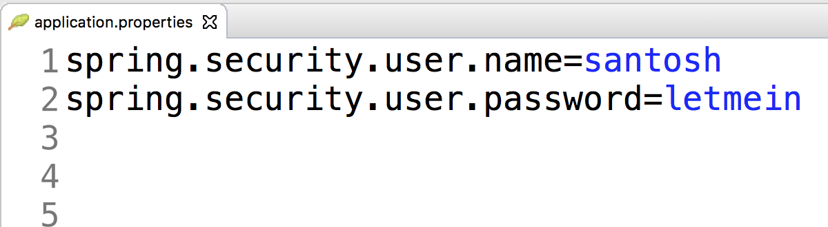
Configuring Spring Security Step-2: configure security username/password
Username: santosh
Password: letmein

Slide 65

Spring Cloud

Slide 66
What is Spring Cloud?
Spring Cloud provides tools for developers to quickly build some of the common patterns in distributed systems, e.g.
configuration management
service discovery
circuit breakers
Routing and messaging
micro-proxy
one-time tokens
global locks
distributed sessions,
cluster state
…… More

Slide 67
Spring Cloud Config

Slide 68
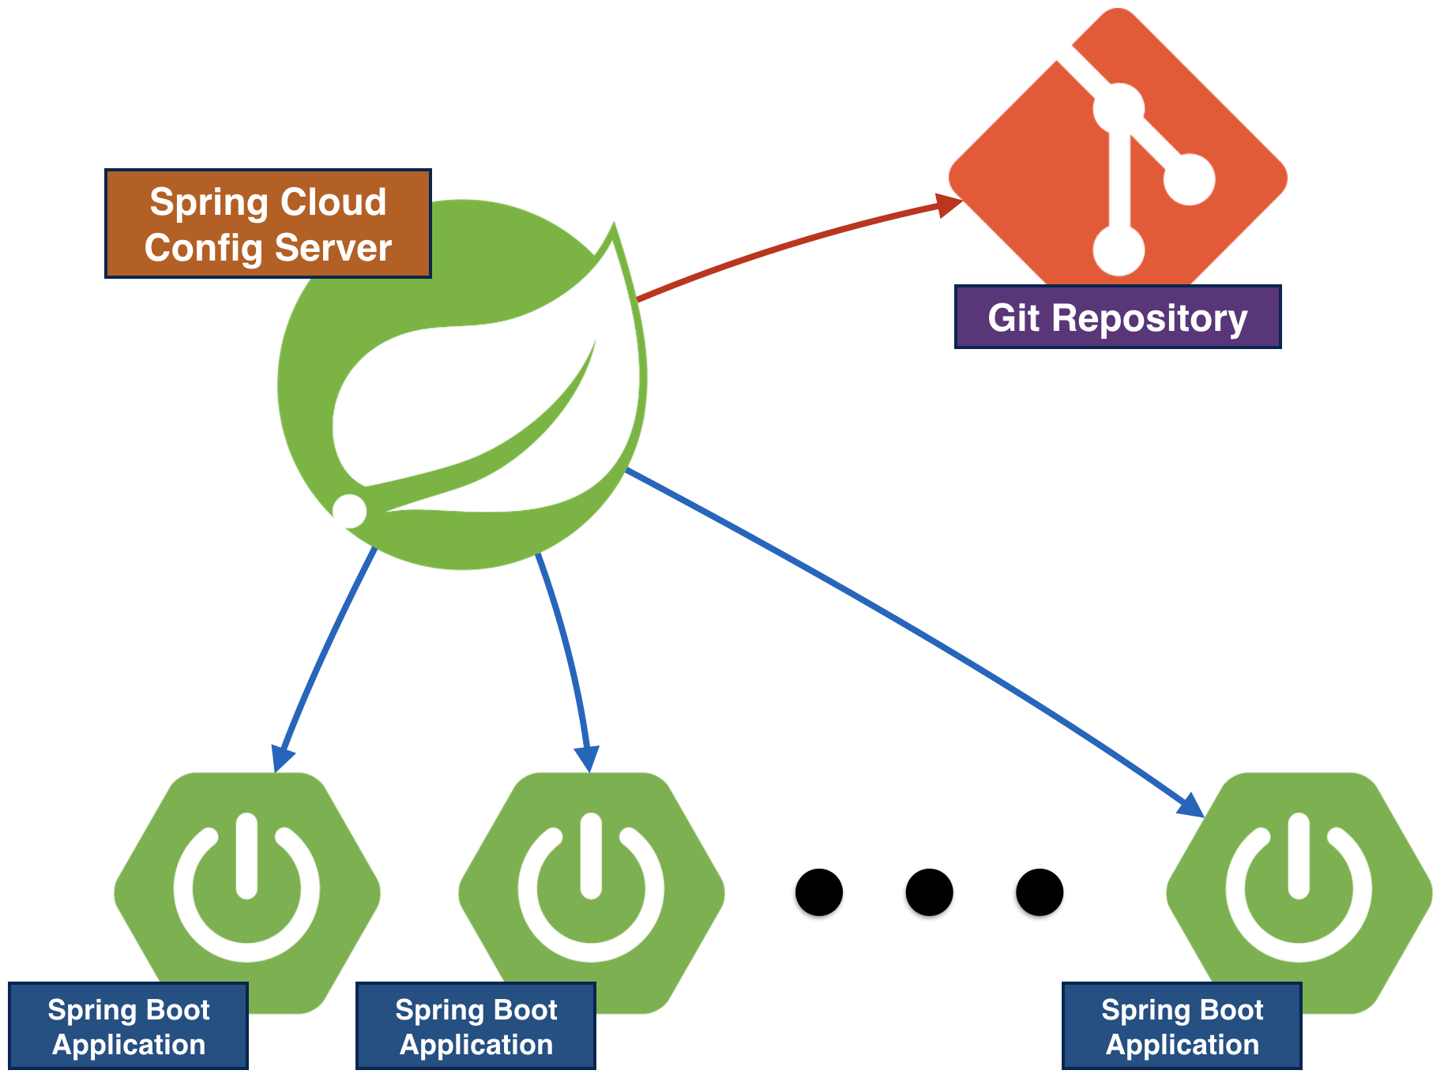
Config
We want to remove the configuration out of the application to a Centralized store across all enviroments.
Spring Cloud Config server can use GIT, SVN, filesystem and Vault to store config
Config Client (Microservice app) retrieve the configuration from the server on startup.

Slide 69
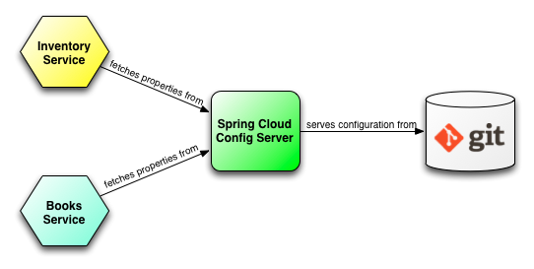
Config

Slide 70
Config Server
Config server holds the details of the configration that can be used in the client.
Each config server refers to one of the GIT repository where we do place required .properties or .yml files
The .properties/.yml files can be for multiple environments e.g.
application.properties -> common for all environments
application_dev.properties -> For DEV environment
application_sit.properties -> For SIT environment
application_prod.properties -> For Prod environment

Slide 71
Steps for writing config server
Add dependency for spring-cloud-starter-config
Add annotation - @EnableConfigServer
Create a GIT repository and clone to your local machine
Configure server location and port in application.properties
Add GIT URI where we store configuration
Add port (usually 8888 for config server)
Now run the test the application through the URL to ensure the application is up and running

Slide 72
Config server – 1. Add dependency
<dependency>
<groupId>org.springframework.cloud</groupId>
<artifactId>spring-cloud-config-server</artifactId>
</dependency>

Slide 73
Config server – 2. Add annotation - @EnableConfigServer
@SpringBootApplication
@EnableConfigServer
public class MyConfigServerApplication {
public static void main(String[] args) {
SpringApplication.run(MyConfigServerApplication.class, args);
}
}

Slide 74
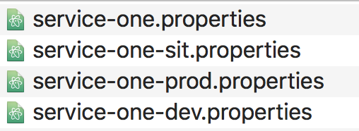
Config server – 3. Create GIT repository & clone to local path
There are different ways. The easiest way is:
Create a repository in the GIT
In your local path, use > git clone <repository URL>
Place the correct configuration (e.g. *.properties)
Commit the file

Slide 75
Config server – 4. Configure server location and port in application.properties
### In MAC ###
spring.cloud.config.server.git.uri=/Users/santoshkumarkar/learning-config-repo
server.port=8888
### In Windows ###
spring.cloud.config.server.git.uri=${USERPROFILE}\\Desktop\\learning-config-repo
server.port=8888

Slide 76
Config server – 4. Testing the URL to ensure the config server is up
Now we have to ensure the config server is up and running.
When the application is up, then only the client can use the configuration from the config server.
http://localhost:8888/<property_file_name>/<profile>
http://localhost:8888/ service-one/dev
OR
http://localhost:8888/ service-one/prod

Slide 77
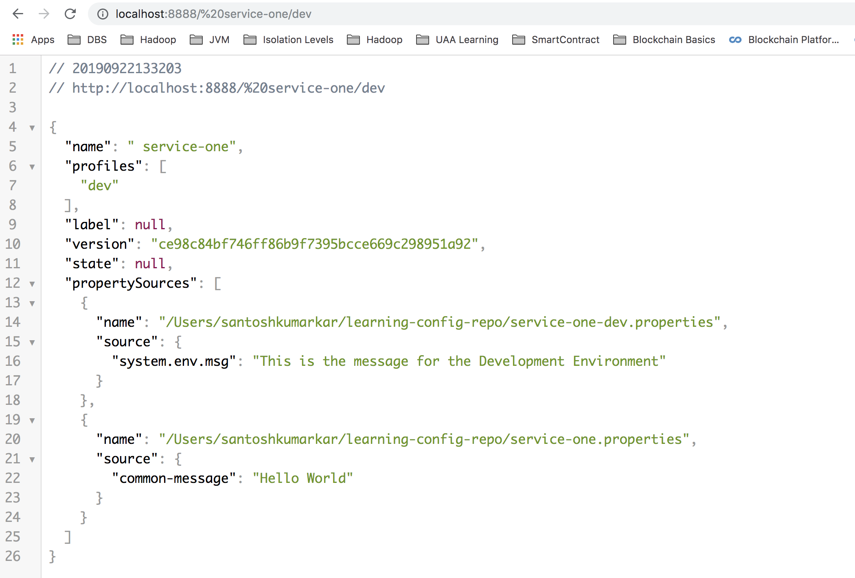
URL

Slide 78
Config Client
Config client is not any specific application. It’s just a simple Microservice
As the main aim of Cloud Config is maintaining centralized configuration, we are NOT going to maintain any configuration properties in the application. Rather we are going to use them.
Before startig the application, it must read the config server details. So required configuration should written in bootstrap.properties/boorstrap.yml
Adding config URI, this is the URL of the config client app
Declare the active profile (e.g. dev or sit or prod)
Please make sure the the config server is up before running the client.

Slide 79
Steps for writing config Client
Add dependency for spring-cloud-starter-config
Define server details in bootstrap.properties to read the configuration from
spring.application.name should be same as the name of property file in config server
spring.cloud.config.uri should be the URL of the config server
spring.profiles.active is the environement to read the correct property file

Slide 80
Config client– 1. Add dependency
<dependency>
<groupId>org.springframework.cloud</groupId>
<artifactId>spring-cloud-starter-config</artifactId>
</dependency>

Slide 81
Config client– 2. bootstrap.properties
The bootstrap.properties/bootstrap.yml is a specific file from Spring Cloud
it’s loaded before the application.properties/application.yml
Please make sure, whatever the name of the property file you use in the config server, you need to use the same name for the application.name in bootstrap.properties
bootstrap.properties
spring.application.name=service-one
spring.cloud.config.uri=http://localhost:8888
spring.profiles.active=dev

Slide 82
Service Discovery

Slide 83
Why Service Discovery
In a micro-service architecture, there will be multiple micro-services running in different servers.
Microservices may communicate to each other. They use the service through the URL. But there could be the problem
The URI of the service may change at anytime because of changes of
Data center they are located in
The region they are located in
The no. of instances that are available
Other changes
Very challenging to configure

Slide 84
Why Service Discovery (contd.)
Service Discovery track records of component of services such as
The current URL of the application
How many instances are available/running
The status whether they are up/do
The healthy or not
Service Discovery provides a single 'lookup' service
Clients register themselves, discover other registrants

Slide 85
What is Eureka
Eureka is a REST (Representational State Transfer) based service that is primarily used in the AWS cloud for locating services for the purpose of load balancing and failover of middle-tier servers.
We call this service, the Eureka Server
https://github.com/Netflix/eureka/wiki

Slide 86
Service Discovery Frameworks
Netfilx Eureka (the most popular)
Apache Zookeeper
Consul
Etdc
SmartStack

Slide 87
Making Eureka Server
Add starter dependency - spring-cloud-starter-netflix-eureka-server
Use annotation - @EnableEurekaServer
In application.properties
Use the commonly used port (8761)
eureka.client.register-with-eureka=false
eureka.client.fetch-registry=false
Can run multiple instances of Eureka Server for high availability

Slide 88
Eureka Server - Dependencies
<dependency>
<groupId>org.springframework.cloud</groupId>
<artifactId>
spring-cloud-starter-netflix-eureka-server
</artifactId>
</dependency>

Slide 89
Eureka Server – Annotation for Eureka Server
@SpringBootApplication
@EnableEurekaServer
public class MyEurekaServerApplication {
public static void main(String[] args) {
SpringApplication.run(MyEurekaServerApplication.class, args);
}
}

Slide 90
Eureka Server – Properties
server.port=8761
eureka.instance.status-page-url=${management.contextPath}/info
eureka.instance.home-page-url-path=${management.contextPath}/health
#eureka.instance.hostname=localhost
# This also can be client because it talks to other Eureka server
eureka.client.register-with-eureka=false
eureka.client.fetch-registry=false
eureka.client.service-url.zone1=http://localhost:8761/
eureka.client.service-url.zone2=http://127.0.0.1:8761/
eureka.client.availability-zones.region1=zone1, zone2
spring.profiles.active: zone1

Slide 91
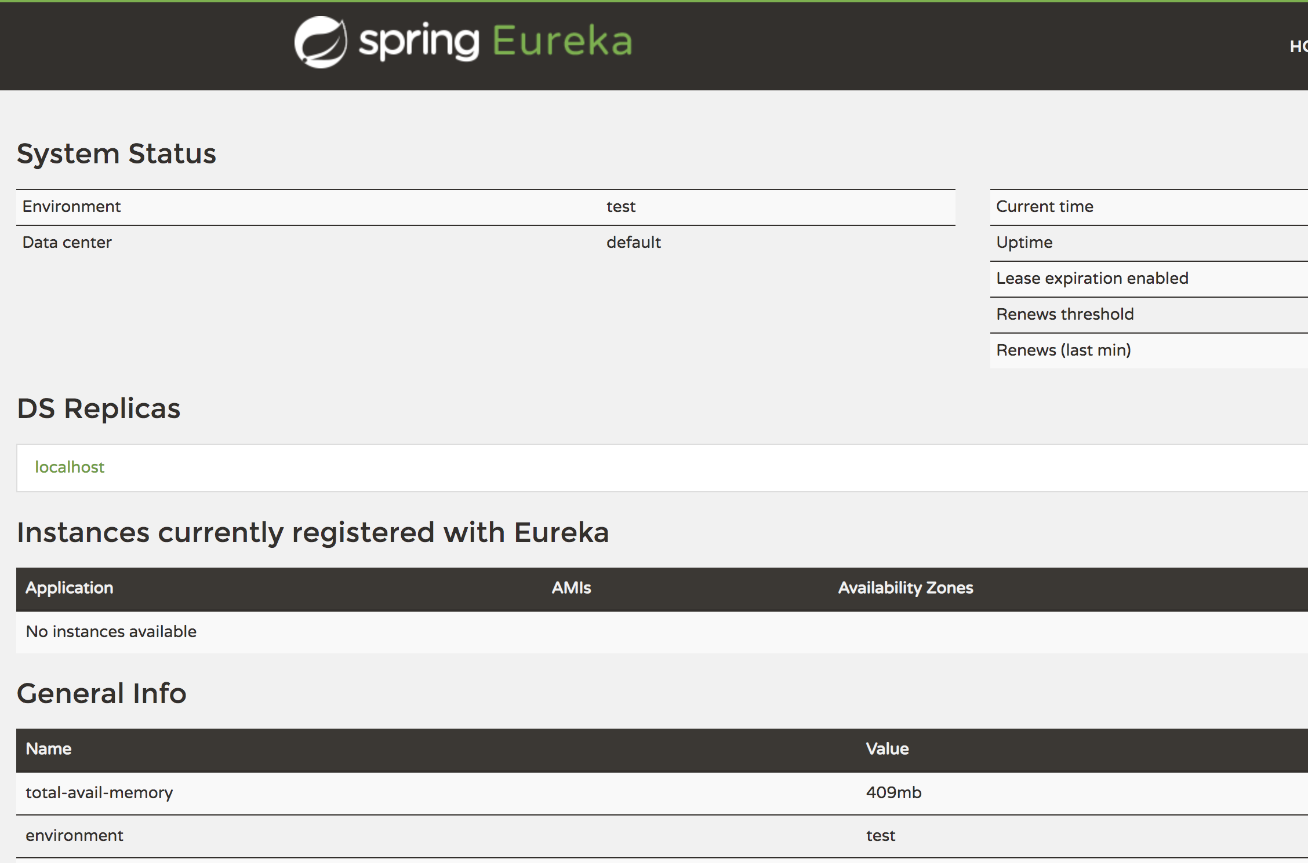
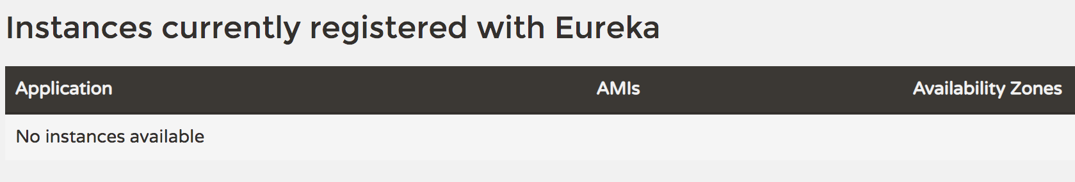
Access the URL
http://localhost:8761
You should be able to access the URL. However you won’t be able to see any client being registered with this server.

Slide 92
Making Eureka Client
Add starter dependency - spring-cloud-starter-netflix-eureka-client
With Other dependencies such as:
spring-boot-starter-web
spring-boot-starter-actuator
Use annotation - @EnableEurekaClient
In application.properties
spring.application.name=<optional: your app name so it will be shown in eureka>
eureka.client.service-url.defaultZone=http://localhost:8761/eureka,http://localhost:8762/eureka

Slide 93
1. Add starter dependency
<dependency>
<groupId>org.springframework.cloud</groupId>
<artifactId>
spring-cloud-starter-netflix-eureka-client
</artifactId>
</dependency>
<dependency>
<groupId>org.springframework.boot</groupId>
<artifactId>spring-boot-starter-web</artifactId>
</dependency>
<dependency>
<groupId>org.springframework.boot</groupId>
<artifactId>spring-boot-starter-actuator</artifactId>
</dependency>

Slide 94
2. Use annotation
@EnableEurekaClient
@SpringBootApplication
public class MyEurekaClientApplication {
public static void main(String[] args) {
SpringApplication.run(MyEurekaClientApplication.class, args);
}
}

Slide 95
3. application.properties
spring.application.name=First Eureka Client
eureka.client.service-url.defaultZone=http://localhost:8761/eureka
Client can be registered in multiple servers. In that case, you can use multiple URLs
eureka.client.service-url.defaultZone=http://localhost:8761/eureka,http://localhost:8762/eureka

Slide 96
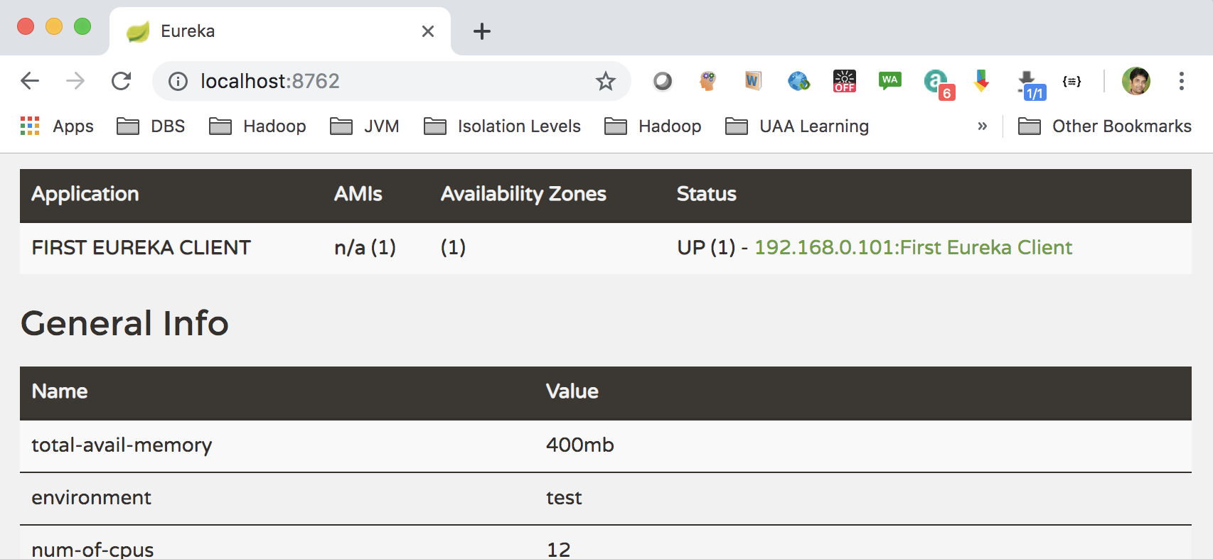
Now run the client
Now you run the web client. After running, you should see the app registered with the Eureka server

Slide 98

Questions
Send to skkar.2k2@gmail.com

